Slide 1
CodeCraft
ACID MINE DRAINAGE (AMD) & DECENTRALISED WATER TREATMENT
SMART WATER QUALITY MONITORING AND AUTOMATED RESPONSE SYSTEM

Slide 2
Introduction
Mpumalanga is one of South Africa’s major coal-mining regions. Mining activities can produce contaminated and acidic runoff that can enter rivers and groundwater.
This pollution can affect water used by communities, farmers, livestock and ecosystems.
Our project focuses on detecting changes in water quality early and enabling a rapid automated response before contamination can cause greater harm.

Slide 3
Problem Statement
Coal mining can expose minerals that react with water and produce acid mine drainage and toxic runoff.
This can introduce pollutants such as sulphates, iron and manganese into water sources.
The main problems are:
-Water sources can become contaminated.
-Traditional monitoring may not provide an immediate response.

Slide 4
THE IMPACT OF MINING WATER eMalahleni (Witbank): This heavily mined hub faces relentless structural strain. Recent Statistics South Africa data reveals that 66,9% of households in Mpumalanga suffer from chronic water interruptions. In eMalahleni, residents frequently open taps to find dark brown, heavily oxidized water loaded with sediment. The municipal water management system is in a state of collapse, highlighted by a landmark R650 million High Court fine

Slide 5
SOLUTION
M.I.M.I-Microcontrolled Intergrated Monitoring Interface
Our solution uses a small autonomous submarine that moves around the mine-water discharge area while continuously sensing the water for acidity. When it detects dangerously acidic water, the system triggers a motorised shut-off valve, causing the valve to close and stop flow of contaminated water. The 3D digital twin then displays the detected contamination area and the valve response by closing

Slide 6
Target market:B2B/GOVERNMENT/Municipalities
FARMERS
-Protect water used for crops and livestock
-Allowing farmers not not use contaminated water
Mining Companies
-Helps detects pollution early and reduce environmental damage and potential legal costs and fines
Municipalities
-Municipalities benefits by detecting water contaminations early, responding quickly and protecting local water systems and rivers while also avoiding fines from the high court

Slide 7
Production costs:
-Parts cost (adruino,sensor,motor)-R600-R800
Industrial enclosure (R300-R500)
-Assembley-R200 estimated total production cost:R1100 –R1500

Slide 8
Proposed Selling price and profit margin
-B2B industrial rate-R4500 to R7500
Gross margin profit between a health 65% to 75%

Slide 9
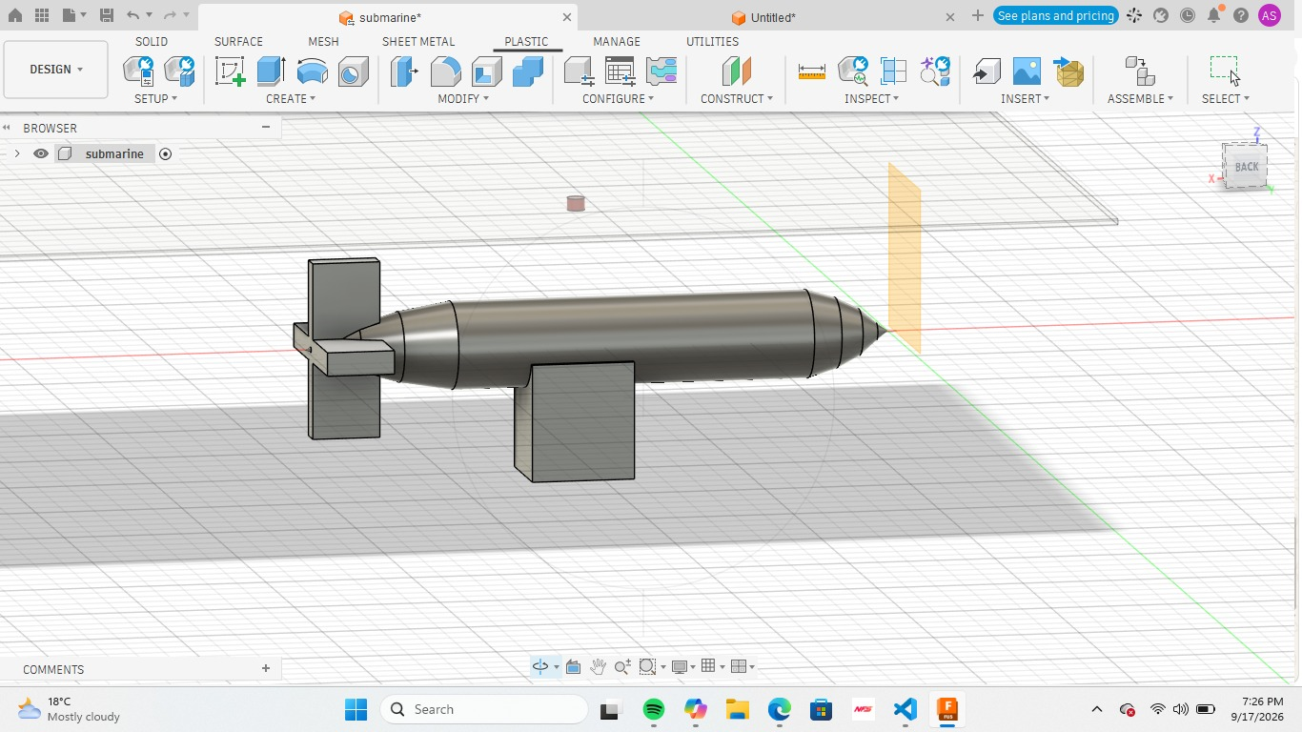
THE SOLUTION ARCHITECTURE

Slide 10
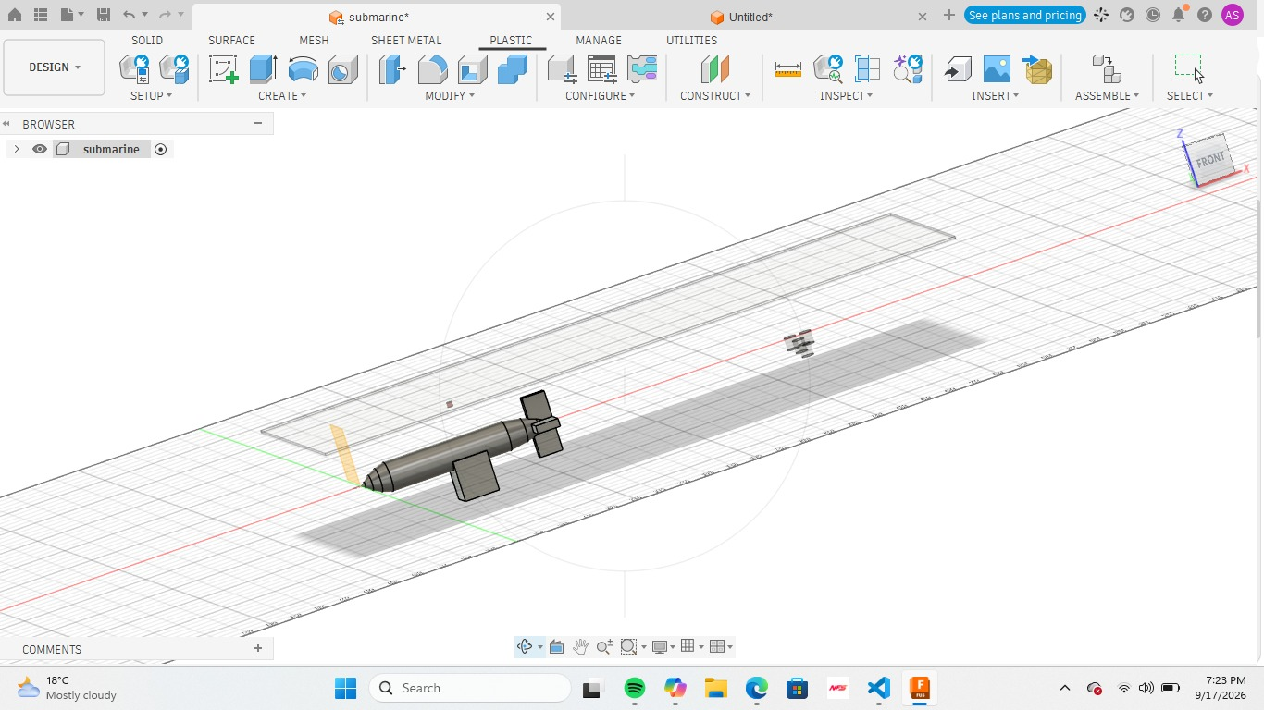

Slide 11
How our system works
Prototype features
-AUTONOMUS Mobility-navigating independently
-Gas leak detection-continouslyu sniffs toxic or flammabke
-Identifies water Contamination
-Real-Time Location Tracking
-Water pressure and depth detector
-When conytami
USER INTERFACE
-DISPLAY LOCATION OF THE SUBMARINE
-SHOWS LOCATION OF POTENTIAL LEAKS AND CONTAMINATIONS

